Slide 1

Lecture 8 Networking
CITS5503 Cloud Computing
Dr David Glance
Some slides courtesy Stephen Kim

Slide 2
Networking
Creating cloud resources requires some knowledge of networks
Major focus is on TCP/IP (UDP not so much) as this is the basis for HTTP(S)/TLS
Focus on IPv4 addressing rather than IPv6 as the latter still not significantly supported (in Australia)
Need a basic understanding of concepts like:
Routing
Private and public networks
Network latency and throughput

Slide 3
TCP/IP Addressing
IPv4 (where IP is used it implies IPv4) address is made up of 4 bytes and represented as:
nnn.nnn.nnn.nnn
130.95.172.57 (www.csse.uwa.edu.au)
Translation between name and IP address done by Domain Name System (DNS)
Specific ranges of IP addresses reserved as Private Addresses:
RFC1918 name | IP address range | Number of addresses | Largest CIDR block (subnet mask)
24-bit block | 10.0.0.0 – 10.255.255.255 | 16,777,216 | 10.0.0.0/8 (255.0.0.0)
20-bit block | 172.16.0.0 – 172.31.255.255 | 1,048,576 | 172.16.0.0/12 (255.240.0.0)
16-bit block | 192.168.0.0 – 192.168.255.255 | 65,536 | 192.168.0.0/16 (255.255.0.0)
Carrier-Grade NAT | 100.64.0.0 – 100.127.255.255 | 4,194,304 | 100.64.0.0/10 (255.192.0.0)

Slide 4
Networks and Hosts
To route a TCP/IP packet on the Internet, need to know its destination
Determined by its network address and host address on that network
Configuration of network interface is done with an IP address and Subnet mask
130.95.172.57 with Mask 255.255.255.0
Network address is 130.95.172.57 AND 255.255.255.0 → 130.95.172.0
Host address is 130.95.172.57 AND complement of 255.255.255.0
130.95.172.57 AND 0.0.0.255 → 0.0.0.57
Network addressing is done using Classless Inter-Domain Routing (CIDR)
Special addresses: First address is network address, Last address is broadcast (all hosts) address

Slide 5
CIDR Examples
CIDR allows us to subnet IP addresses for:
performance
administration e.g. An organisation is given a subnet:
130.95.141.192 Netmask: 255.255.255.192
192 is 1100 0000
This works out as 130.95.141.192/26 = 64 hosts

Slide 6
CIDR Examples
A: 172.16.17.30/20
B: 172.16.28.15/20
Are they on the same subnet?
First address is done using a bitwise AND on the address and subnet mask
172.16.17.30 - 10101100.00010000.00010001.00011110
255.255.240.0 - 11111111.11111111.11110000.00000000
-----------------|AND|-------------
subnet = 10101100.00010000.00010000.00000000 = 172.16.16.0
Last address is done using a bitwise OR on the address and the complement of the mask
172.16.17.30 - 10101100.00010000.00010001.00011110
255.255.240.0 - 00000000.00000000.00001111.11111111
-----------------|OR|--------------
subnet = 10101100.00010000.00011111.11111111 = 172.16.32.255

Slide 7
Classless Inter-Domain Routing (CIDR)
Addresses | bits | prefix | class | Subnet Mask
1 | 0 | /32 | - | 255.255.255.255
2 | 1 | /31 | - | 255.255.255.254
4 | 2 | /30 | - | 255.255.255.252
8 | 3 | /29 | - | 255.255.255.248
16 | 4 | /28 | - | 255.255.255.240
.. | .. | .. | .. | ..
512 | 9 | /23 | 2C | 255.255.254.0
1K | 10 | /22 | 4C | 255.255.252.0
.. | .. | .. | .. | ..
64K | 16 | /16 | 1B | 255.255.0.0
128K | 17 | /15 | 2B | 255.254.0.0
256K | 18 | /14 | 4B | 255.252.0.0
512K | 19 | /13 | 8B | 255.248.0.0
1M | 20 | /12 | 16B | 255.240.0.0
2M | 21 | /11 | 32B | 255.224.0.0
4M | 22 | /10 | 64B | 255.192.0.0
.. | .. | .. | .. | ..
128M | 27 | /5 | 8A | 248.0.0.0
256M | 28 | /4 | 16A | 240.0.0.0
512M | 29 | /3 | 32A | 224.0.0.0
1024M | 30 | /2 | 64A | 192.0.0.0
Notes:
With the advent of CIDR, the classful restrictions no longer exist. Address space may be allocated and assigned on bit boundaries, and routers may use one aggregated route (like 194.145.96.0/20) instead of advertising 16 class C addresses [RFC-1518].
'addrs' represents the number of addresses available; note that the number of addressable hosts normally is 2 less than this number because the host parts with all equal bits (all 0s and all 1s) are reserved. 'bits' represents the size of the allocation/assignment in bits of address space.
'prefix' represents the length of the route prefix covering this address space. This is sometimes used to indicate the size of an allocation/assignment. 'class' represents the size of the address space in terms of classful network numbers. 'mask' represents the network mask defining the routing prefix in dotted decimal notation.

Slide 8

Routing in IPv4
A router has two addresses
An address through which the device inside of the router can be accessed.
Another address belongs to the granted block (subnetwork).
If this network is public it is advertised to route traffic to it
Internet
123.35.0.0/28
Public Subnet
200.4.25.8

Slide 9
IPv4 exhaustion
There are only 4.3 billion IP addresses and they have been officially exhausted
Solutions:
IPv6 which has 3.4*10³⁸ addresses
Network Address Translation
CIDR which allowed smaller chunks of IP addresses to be handed out
IPv6 is progressing but Australia slow to adopt
NAT and carrier-grade NAT more common
NAT also provides other benefits

Slide 10
Network Address Translation (NAT)
Benefits
Use of a single IP address among many devices in a network
Use of a dynamic IP address for home user for sharing
Private Addresses
Range | Total
10.0.0.0 to 10.255.255.255 | 2²⁴
172.16.0.0 to 172.31.255.255 | 2²⁰
192.168.0.0 to 192.168.255.255 | 2¹⁶

Slide 11
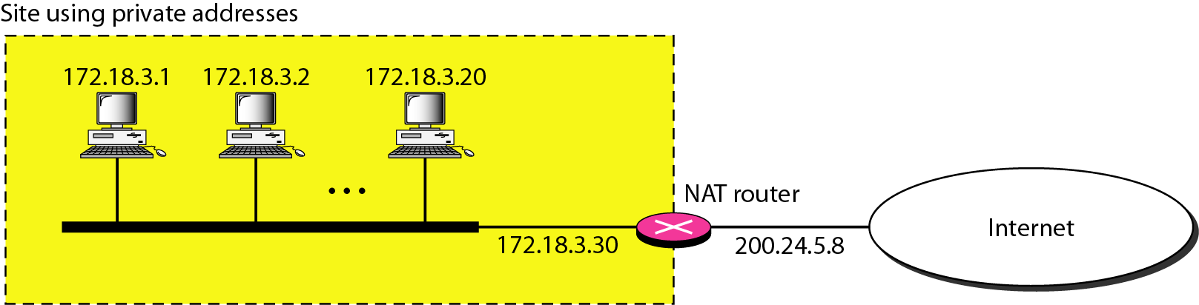
NAT Configuration

Slide 12
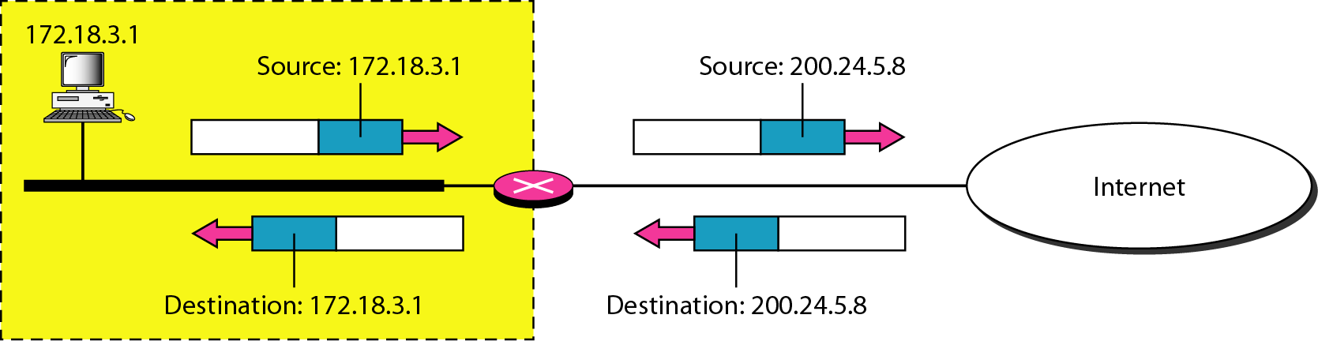
Address Translation

Slide 13
AWS Network
EC2 need to be launched into a Virtual Private Cloud (VPC)
Default VPC defines:
An address space (IPv4 and IPv6): 172.31.0.0/16 (65,536 addresses)
Subnet in each availability zone: e.g. 172.31.0.0/20 and 172.31.16.0/20
Internet Gateway
Main Route Table
Default Security Group
Default Network Access Control List (ACL)
Default DHCP settings

Slide 14
AWS Default VPC

Slide 15
AWS Default VPC

Slide 16
Subnet
Attributes:
Name
VPC associated
Availability Zone
IPv4 CIDR block
IPv6 CIDR block (optional)

Slide 17
Security
Security Groups can be associated with a VPC but they act at the instance level.
If a security group is not specified for an instance, it takes the one assigned to the VPC
ACLs act on a subnet and have different characteristics than a security group

Slide 18
Security
Security Group | Network ACL
Operates at the instance level (first layer of defense) | Operates at the subnet level (second layer of defense)
Supports allow rules only | Supports allow rules and deny rules
Is stateful: Return traffic is automatically allowed, regardless of any rules | Is stateless: Return traffic must be explicitly allowed by rules
We evaluate all rules before deciding whether to allow traffic | We process rules in number order when deciding whether to allow traffic
Applies to an instance only if someone specifies the security group when launching the instance, or associates the security group with the instance later on | Automatically applies to all instances in the subnets it's associated with (backup layer of defense, so you don't have to rely on someone specifying the security group)

Slide 19
Security

Slide 20
Setting up a NAT Gateway
Used to create a private network
Remember that there are multiple ways to isolate instances
Through security groups and ACLs
Putting instances behind a load balancer
NAT Gateway needs to be part of a public network
Private subnet has a custom route table that points all default traffic to the NAT Gateway
NAT Gateways can not be configured to map ports for inbound traffic (unlike home NAT routers)

Slide 21
Configuring a NAT Gateway

